Slide 1

Watershed Analysis
Final Presentation

Slide 2
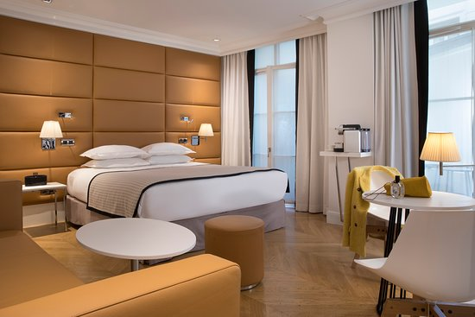
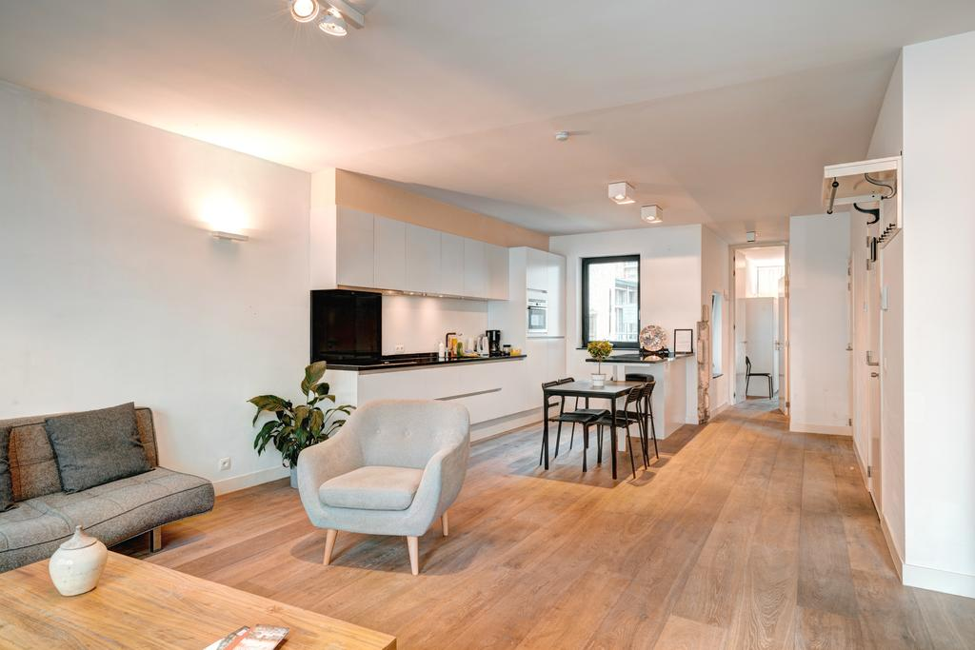
Why?
What does make us feel at home?

Slide 3

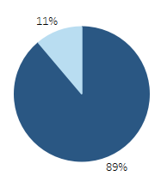
What?
Enter in the short-term rental market
How?
Convert the 17 properties in Austin and Miami
71% of the total profit after the conversion
- Convert the houses with 1 or 2 bedrooms
89% of the properties in Austin and Miami

Slide 4
Results with the recommendations
VS
LT ANNUAL REVENUES: 360,788 $

Slide 5
How robust the prediction?
WORST SCENARIO – 5 properties
-67.1%
-71.8%
BEST SCENARIO – 20 properties
+43.7%
+0.59%

